Slide 1
Experiments
Selecting parameters
Five-fold cross validation based on grid search
Evaluation metrics
Accuracy
Precision
Recall
F1.Score
ROC&&AUC

Slide 2
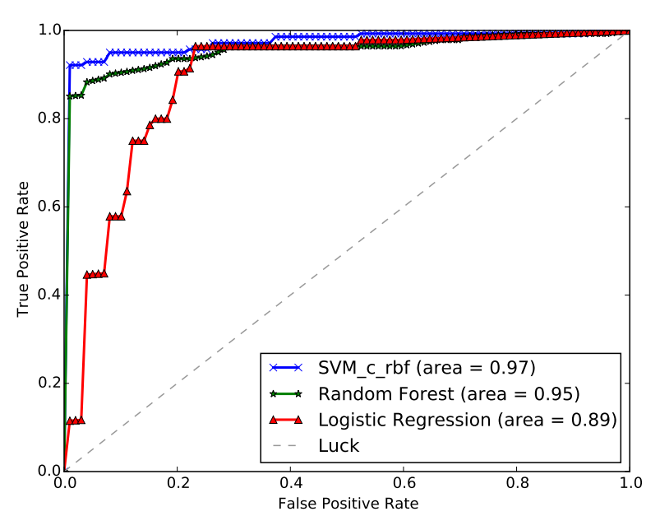
Experiments
Comparison of different single task models
Logistic Regression
SVM with RBF kernel
Random Forests
Coarse-grained single-task models achieve a good outcome
Behavior features are effective to poor performance discovery

Slide 3
Experiments
Comparison between single task and multi-task models
Multi-task model shows good results, especially high recall
Model | Accuracy | Precision | Recall | F1.Score
Logistic regression | 0.84 | 0.74 | 0.82 | 0.83
SVM(RBF kernel) | 0.90 | 0.90 | 0.93 | 0.91
Random Forest | 0.87 | 1.00 | 0.75 | 0.86
MTL | 0.95 | 0.92 | 0.98 | 0.94

Slide 4
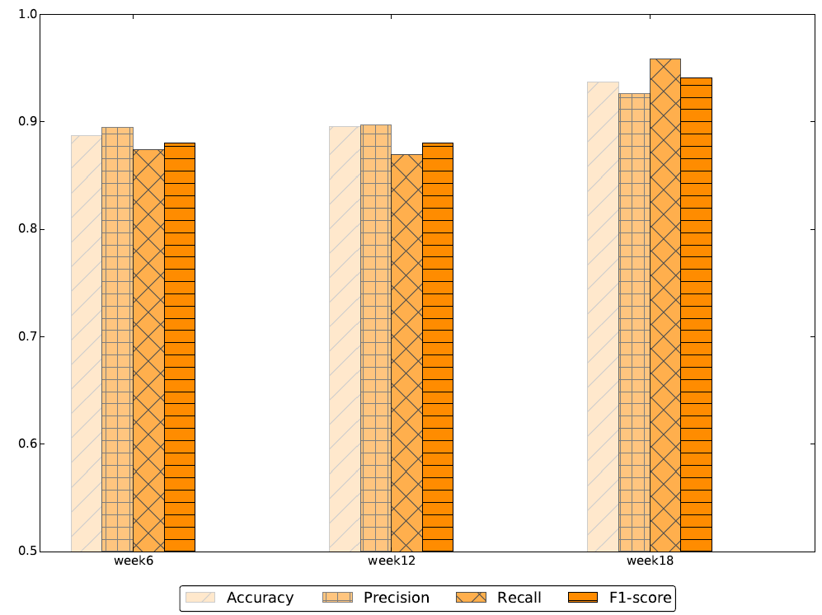
Experiments
Early warning
The metrics are high in the early stage of the semester

Slide 5
Conclusion
A general framework to discover poor performance based on behavior pattern
Build behavior pattern and extraction features
Statistics features
Relevance features
Early warning

Slide 6
Future work
Something about learning to rank
The relationship btween behavior and scholarship

